Slide 1
INSTRUCTIONS
Use Font size 22 to 28 and Font Style Times New Roman (body)
Do not change the Template: Heading / Title of the slides
Do not change font style or colours
Do not copy paste paragraphs: use only Bullet Points
Maximum slide Limit is 20 only
As per the number of supervisor allotted adopt slide-2 or slide-3
Please display the required meaningful Content or images or tables
Change the footer accordingly using insert tab then click on header & footer tab and edit it
Save the PPT with Register No, Dept and Review no, example: 23xxxxxxxxx_CSE

Slide 2

Title:
Student Name: CHALLA POOJITHA
Student ID: 2520090234
Cluster:1
Section: 1
Under the Guidance
of
Supervisor Name: RAMAKANTH
Assistant Professor
Department of CSE

Slide 3
OUTLINE
Abstract
Existing System
Proposed System
System Architecture
Project Modules
Objectives
Co’s Attainments - FWD
Co1
Co2 …….. 5. Co5
Co’s Attainments - DSA
Co1
Co2 …….. 5. Co5
Screen Shots for FWD & DSA
Conclusion
Geo-Tagged Photos

Slide 4
Abstract
The Automated Time-Driven Digital Notice Board System is a modern solution designed to replace traditional physical notice boards in colleges, offices, and apartments.
It allows users to create and publish notices with details such as title, description, posted time, expiry time, and priority level (high, medium, low).
The system automatically removes or archives expired notices, ensuring that only relevant and up-to-date information is displayed.
Users can view notices directly on the website, making announcements easily accessible.
The system is developed using Java by applying concepts such as classes, objects, methods, arrays/ArrayList, and control structures to manage notice data and program operations.
Java handles user input (Scanner), notice storage (ArrayList), and logic implementation (loops, conditions, and methods) to add, display, sort, and remove notices based on priority and expiry time.

Slide 5
Existing System
Most institutions rely on traditional physical notice boards to display announcements.
Notices are printed on paper and manually pinned to the notice board.
Old and expired notices often remain on the board, creating clutter and confusion.
People must physically visit the notice board to check for updates or new announcements.
Managing and updating notices is time-consuming and requires manual effort.
There is no automatic system to organize notices based on priority or time.
Important announcements can be missed easily due to overcrowded or poorly managed notice boards.

Slide 6
Proposed System
The proposed system introduces automated digital notice board to display announcements online.
Users can create and publish notices with details such as title, description, posted time, expiry time, and priority level.
The system automatically removes or archives expired notices to keep the notice board updated.
Notices can be viewed easily through the website from any location with internet access.
The system allows sorting of notices based on priority and time for better organization.
Users can search and filter notices to quickly find relevant information.
The digital system improves communication efficiency and reduces the use of paper-based notices.

Slide 7
System Architecture
Presentation Layer (User Interface Layer)
Provides the interface through which users interact with the system.
Displays product information, stock details, and system outputs.
Allows users to perform operations such as adding, updating, searching, and viewing inventory records.
Ensures a simple and user-friendly interaction with the system.
Application Layer (Business Logic Layer)
Processes user requests and manages the core functionality of the system.
Implements inventory management logic such as product updates, stock validation, and data processing.
Handles communication between the user interface and the data storage layer.
Ensures proper execution of inventory operations and system rules.
Data Layer (Database Layer)
Responsible for storing and managing all inventory-related data.
Maintains records such as product details, stock quantities, and inventory updates.
Ensures secure data storage and efficient retrieval of information.
Supports data integrity and consistency within the system.
.

Slide 8
Project Modules
User Interface Module Provides an interactive interface for users to access the digital notice board. Allows users to easily navigate, view notices, and interact with system features.
Notice Management Module Allows users to add, edit, delete, and view notices. Maintains notice details such as title, description, posted time, expiry time, and priority level.
Channel Management Module Enables creation and management of different channels for various groups or departments. Allows users to join channels and view notices specific to that channel.
Notice Monitoring Module Automatically checks notice expiry time and removes or archives expired notices. Ensures that only active and relevant notices are displayed on the board.
Data Management Module Stores and manages notice-related information within the system. Ensures accurate storage, retrieval, and consistency of notice data.

Slide 9
Objectives
To design and develop an Automated Time-Driven Digital Notice Board System using java
To replace traditional paper-based notice boards with a digital and automated platform.
To allow users to create and manage notices with details such as title, description, priority, and expiry time.
To automatically remove or archive expired notices to keep information updated.
To enable users to easily view announcements through the website anytime.
To improve communication efficiency and ensure quick access to important information.

Slide 10
Co’s Attainments - DSA
CO1
Analyze problem statements using asymptotic notation (Big-O, Ω, Θ).
Compare algorithm efficiency based on time and space complexity.
Implement and evaluate searching and sorting algorithms in Java.
CO2
Design and implement Abstract Data Types (ADTs) using arrays and linked lists.
Perform operations such as insertion, deletion, searching, and traversal.
Evaluate advantages and limitations of different data structures.
CO3
Apply stacks and queues to solve real-world workflow problems.
Implement circular queues, deques, heaps, and priority queues.
Analyze performance compared to other linear data structures.
CO4
Design hash-based data structures using hashing techniques.
Implement hash tables with chaining and open addressing.
Utilize Java Collections (List, Queue, Deque, Map) for efficient solutions.
CO5
Develop practical applications using linear data structures.
Implement data structures to solve real-world computational problems.

Slide 11
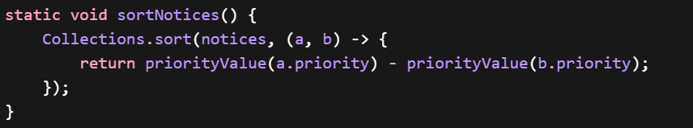
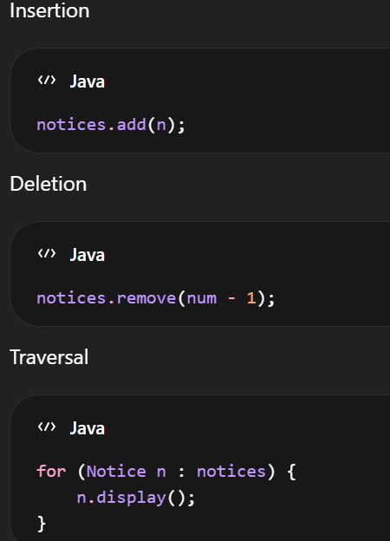

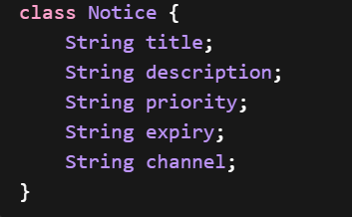
Screenshots for DSA
CO2 – Design and Implement Abstract Data Types (ADTs)
ArrayList (Dynamic Array)
Abstract Data Type implementation
Dynamic data storage
Data structure management
CO1 – Implement and Evaluate Searching and Sorting Algorithms
Sorting algorithm using Collections.sort()
Algorithm efficiency
Comparison of elements
Priority-based ordering
.
CO3 – Perform Operations such as Insertion, Deletion, Searching, and Traversal
Insertion operation
Deletion operation
Traversal using loop
Searching using user input
CO4 – Utilize Java Collections for Efficient Solutions
Java Collections Framework
ArrayList
Collections utility methods
Efficient data handling
CO5 – Develop Practical Applications using Data Structures
Class and Object design
Real-world application development
Data structure usage
Notice data management

Slide 12
Conclusion
The Automated Time-Driven Digital Notice Board System provides an efficient solution for managing and displaying notices digitally.
The system automates posting and removal of notices, reducing manual effort and keeping information updated.
It allows users to easily create, view, and manage notices with important details.
The user-friendly interface ensures quick access to announcements through the website.
The system improves communication and ensures only active notices are displayed.
Future improvements may include user login, real-time notifications, and database integration.

Slide 13
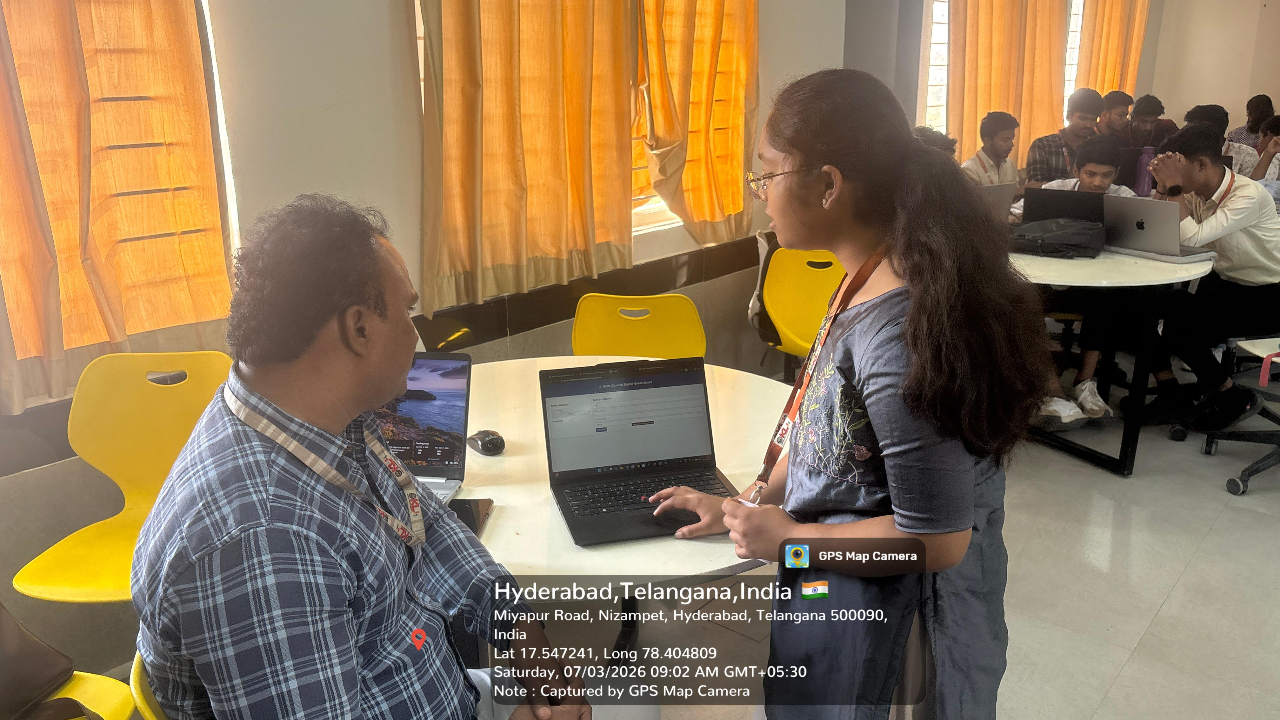
Geo- Tag Photos

Slide 14
THANK YOU

